Slide 1
Introduction to Cyber Security
11.10.2018

Slide 2
What is cyber security?
“Cybersecurity is the practice of protecting systems, networks, and programs from digital attacks. These attacks are usually aimed at accessing, changing, or destroying sensitive information; extorting money from users; or interrupting normal business processes.” - Cisco

Slide 3
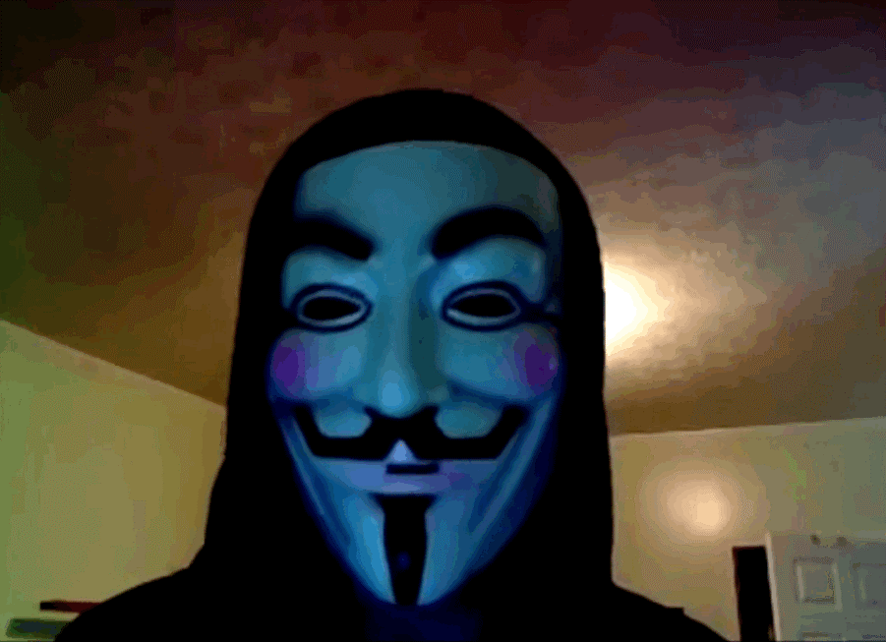
What is cyber security?
“Cybersecurity is the practice of protecting systems, networks, and programs from digital attacks. These attacks are usually aimed at accessing, changing, or destroying sensitive information; extorting money from users; or interrupting normal business processes.” - Cisco

Slide 4
What is vulnerable?

Slide 5
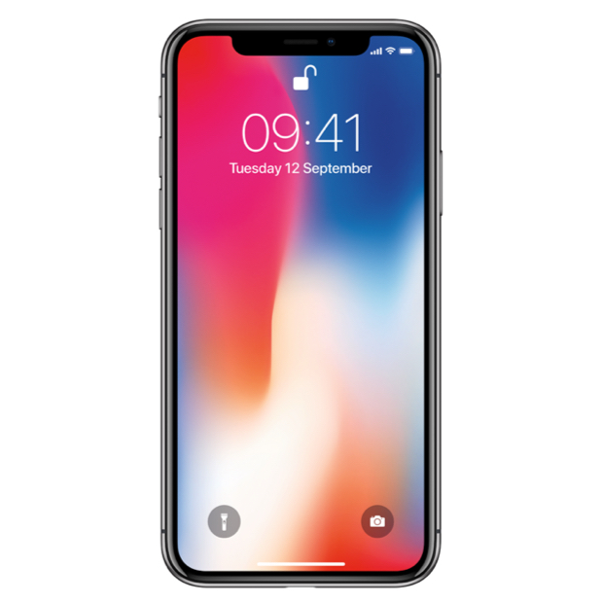


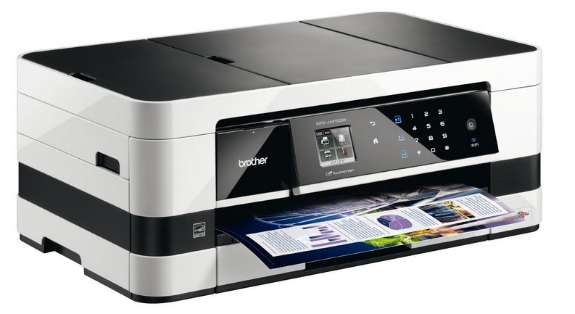

Slide 6
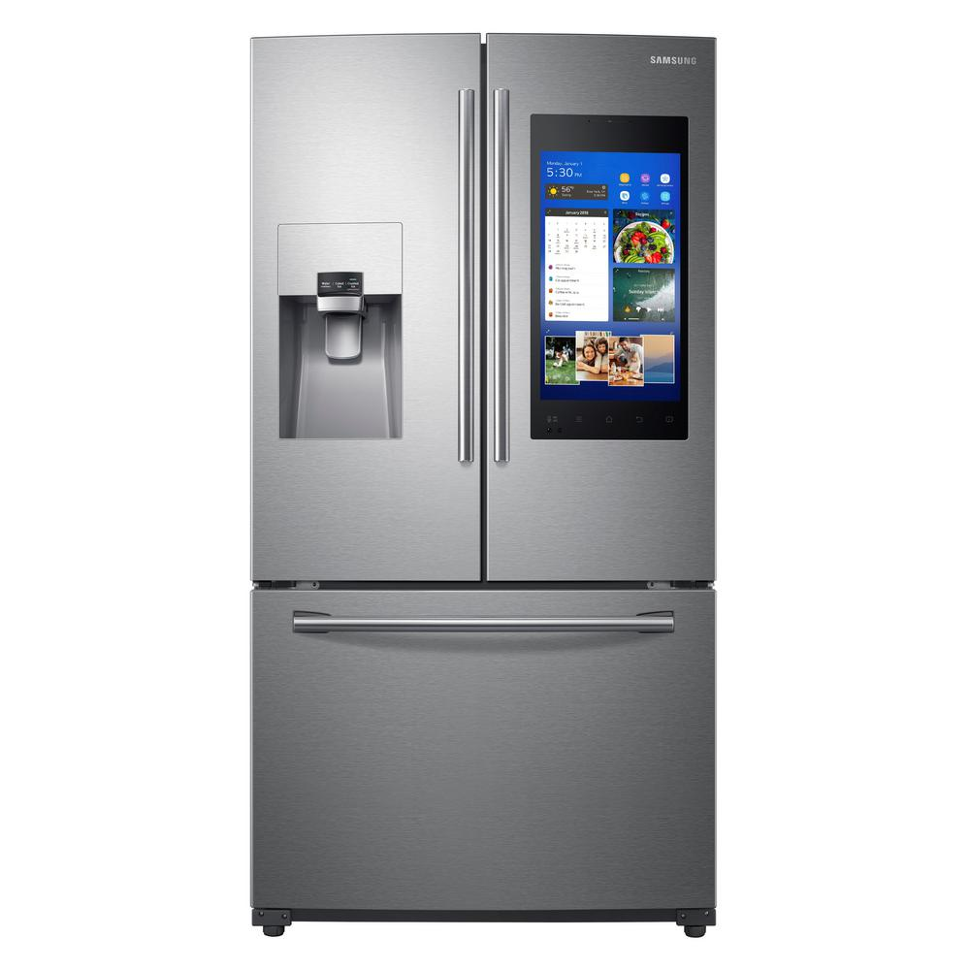


Slide 7
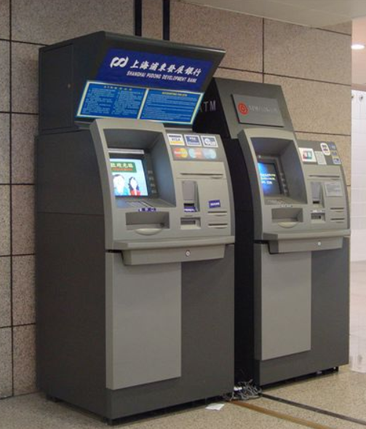

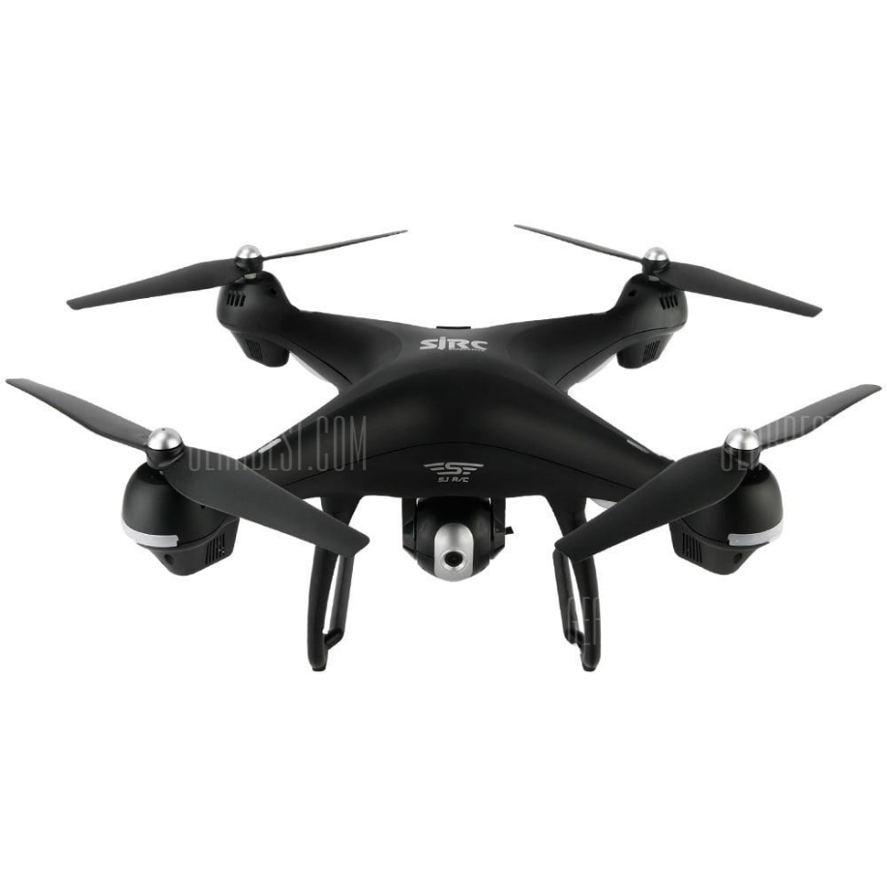

Slide 8

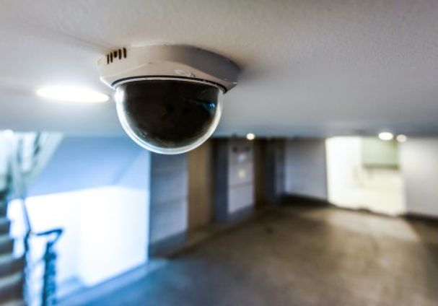

Slide 9
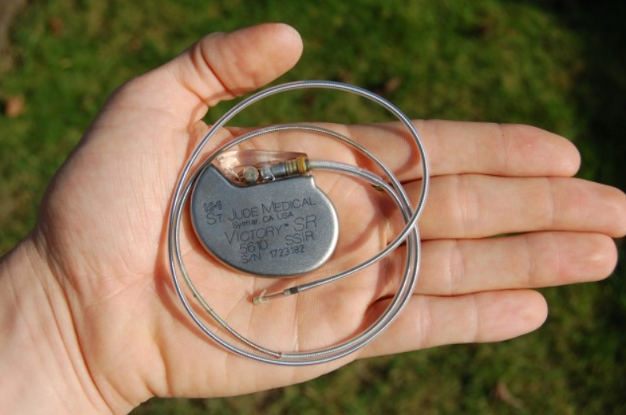
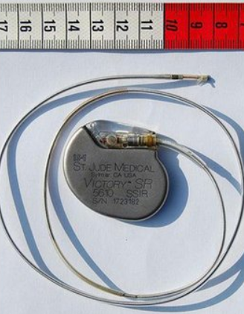

Slide 10
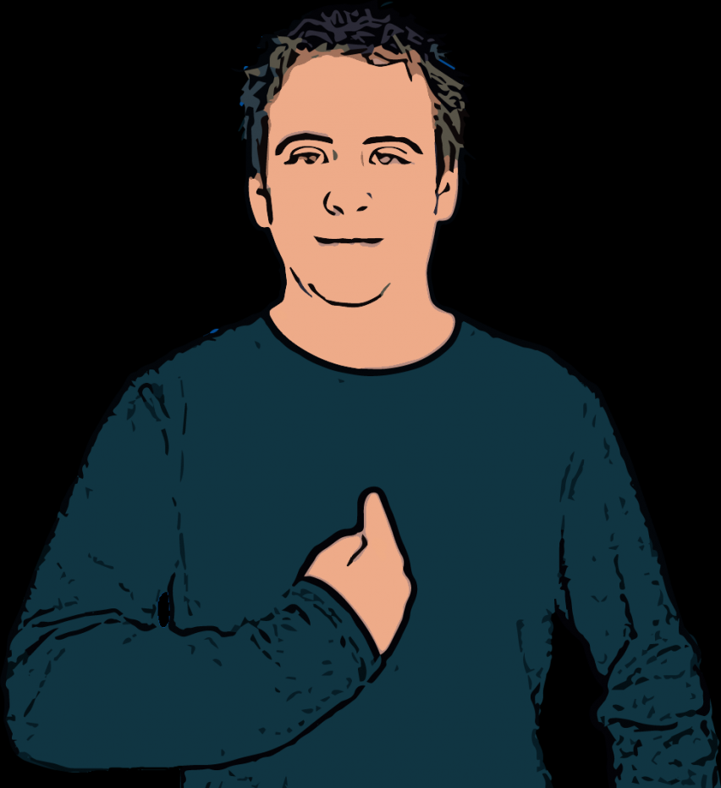

Slide 11
…but I’m no cyborg lmao?
You may not be the target, but easily a victim
Be aware
Be skeptical
Don’t find out when it’s already too late

Slide 12
Goals for tonight
Learn about the most important and trending issues
Raise awareness
Not go into technical detail
Find out how to protect yourself
Go to the Union

Slide 13
Outline
The internet and wireless
Encryption
Protocol downgrade
Famous casualties
Social engineering
Famous casualties
Pizza
Conspiracy
The Big Hack
Other exploits
Malware
CTFs

Slide 14
Traffic encryption
And safety

Slide 15


Slide 16
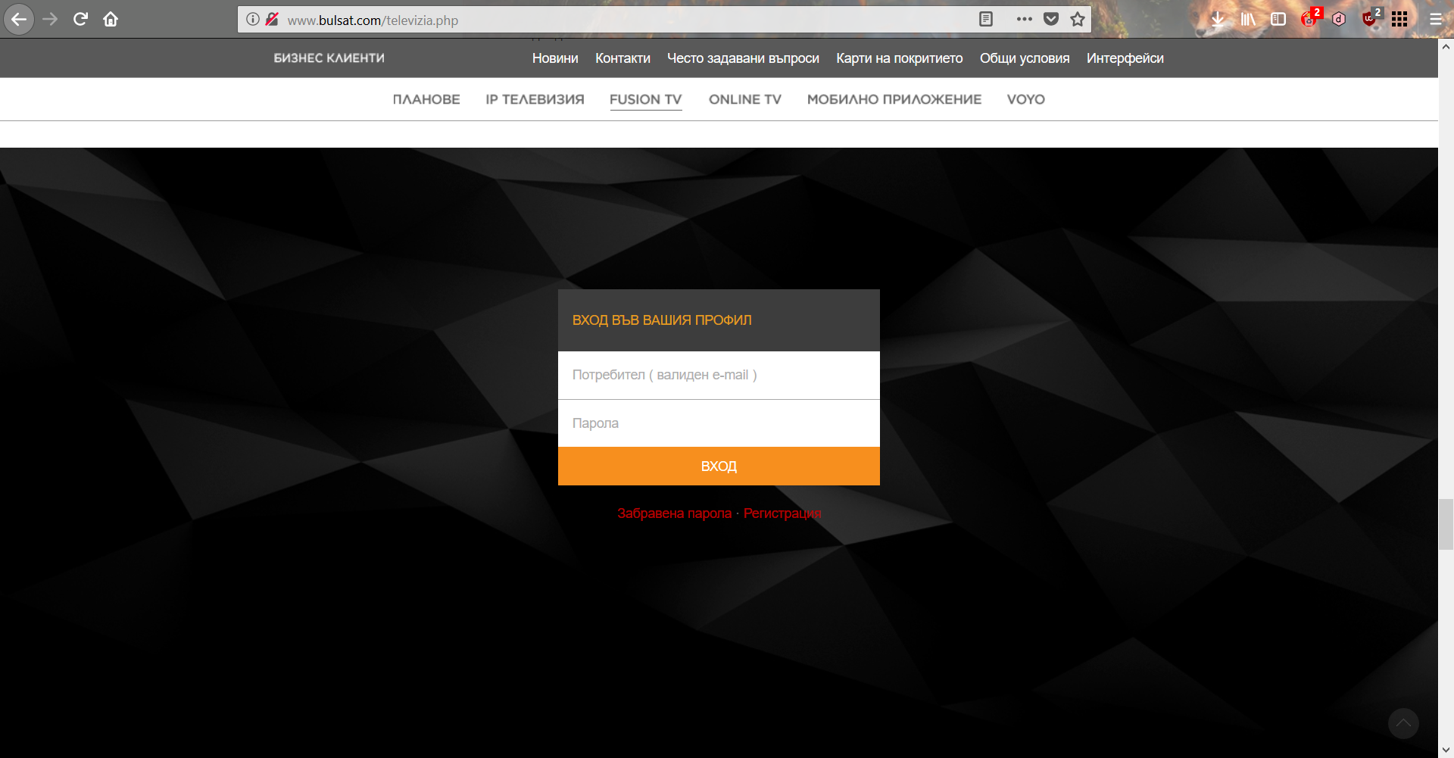

Slide 17
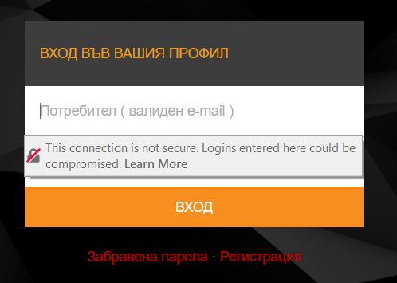

Slide 18
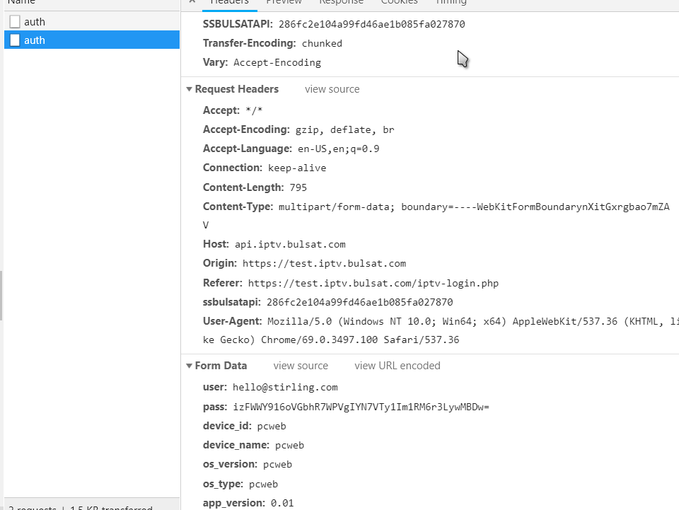

Slide 19
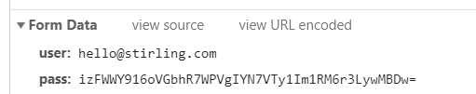

Slide 20
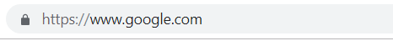

Slide 21
But not everything is encrypted!

Slide 22
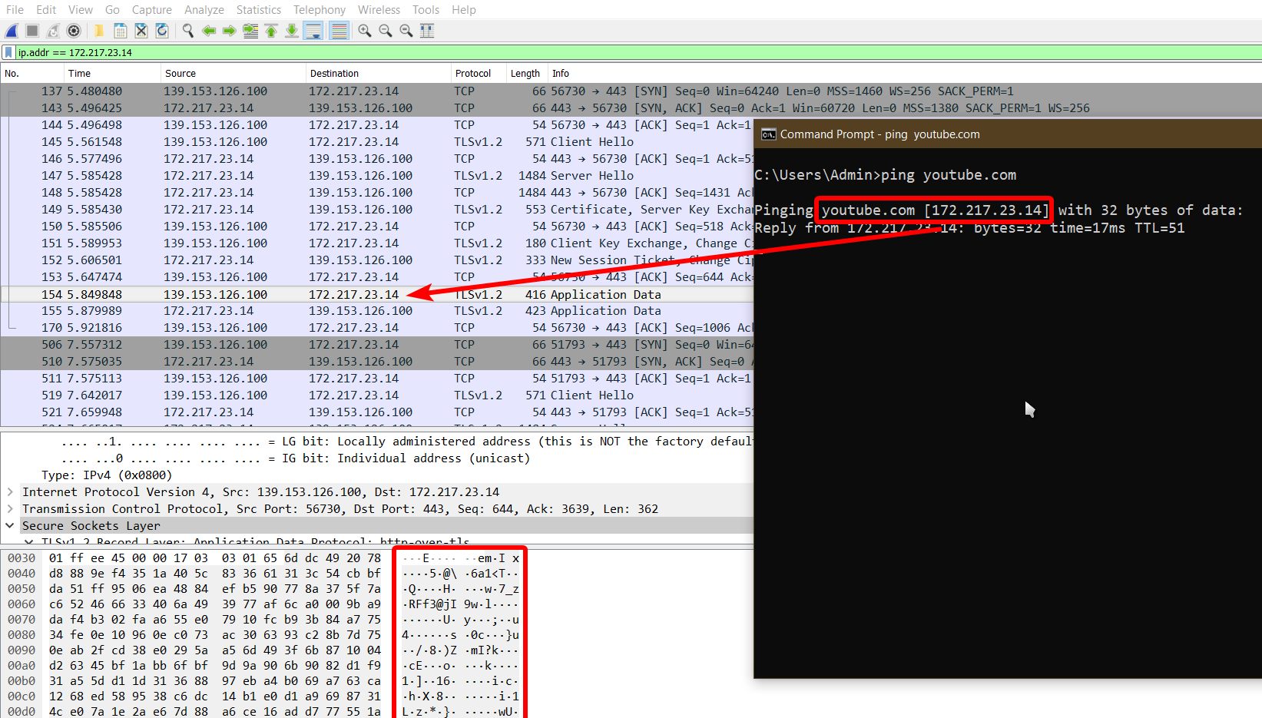

Slide 23

ARP Poisoning
And the unsuspected data medium

Slide 24
It happens to the best, too

Slide 25
It happens to the best too

Slide 26

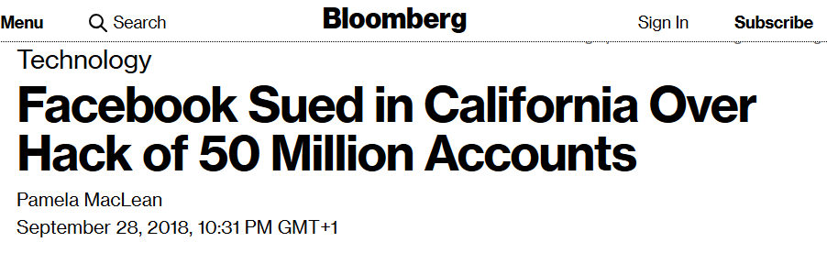
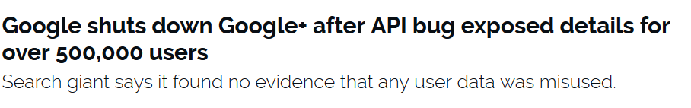

Slide 27
Social engineering
This time You are the target

Slide 28
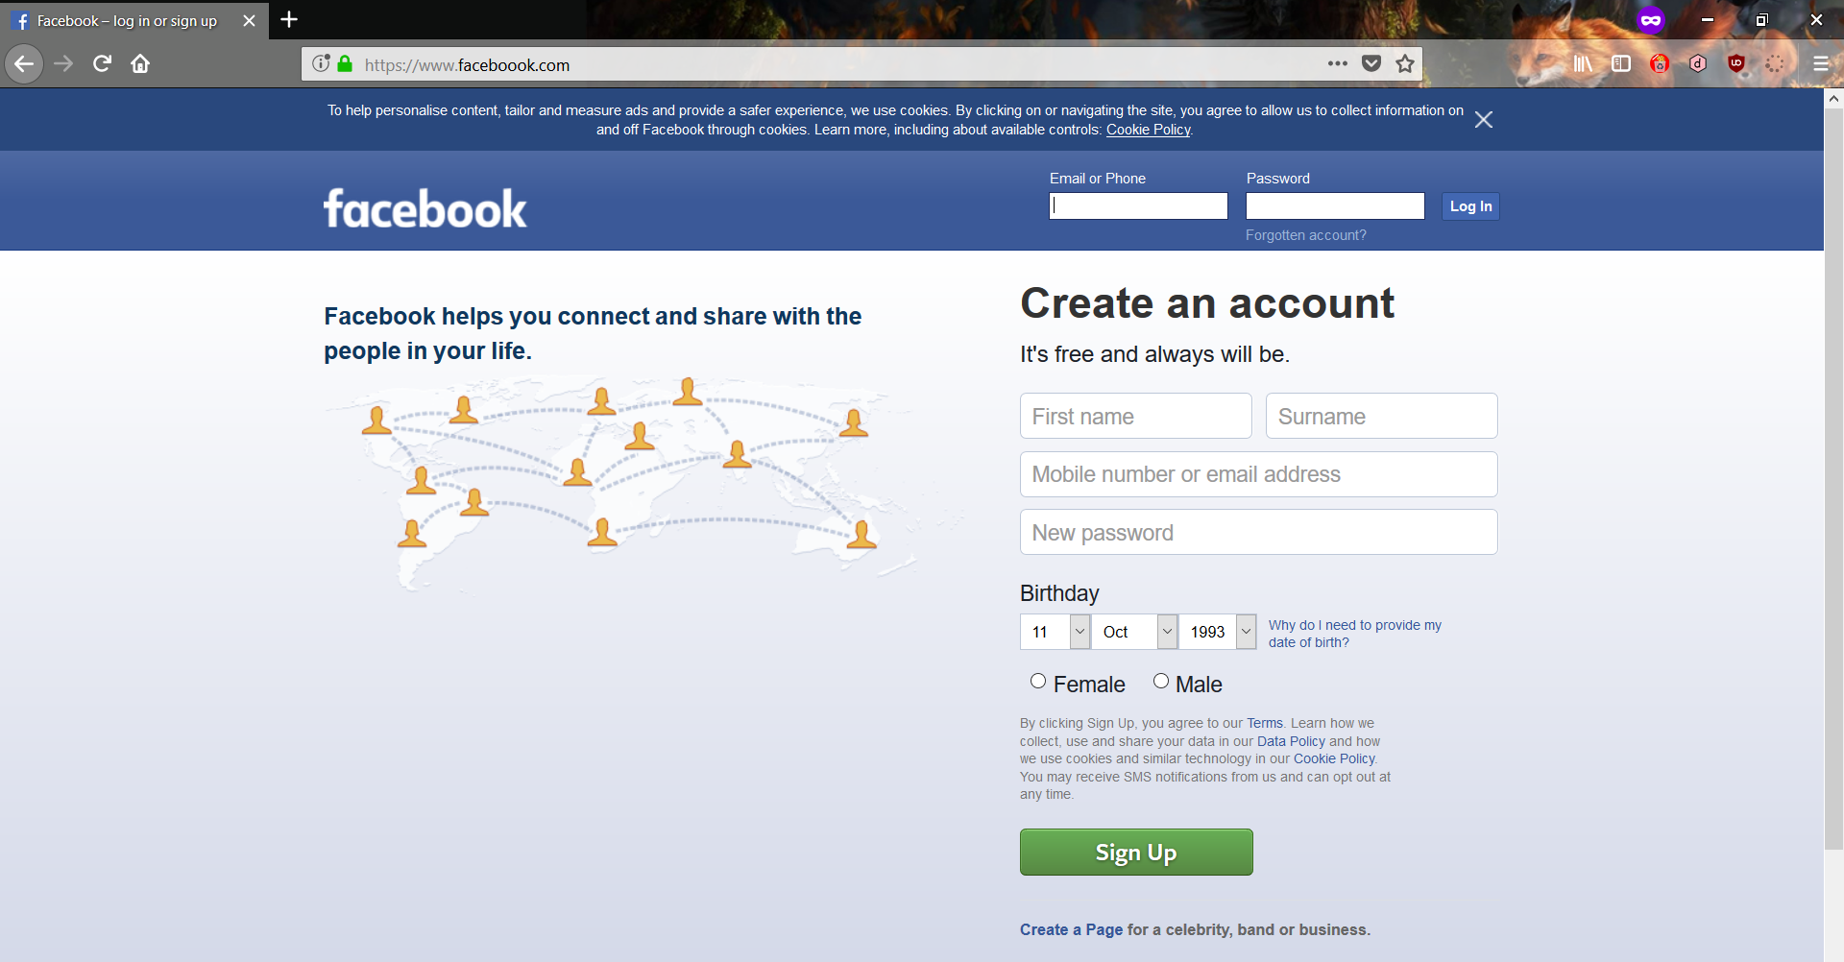

Slide 29

Via message
Via ARP
Other trickery?

Slide 30
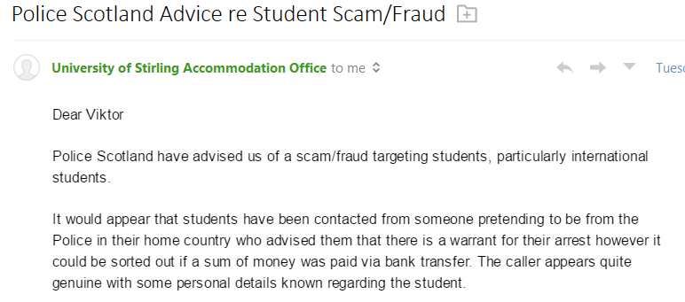

Slide 31
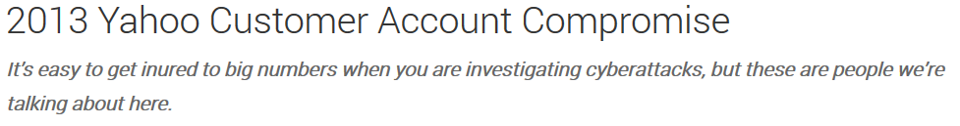
One privileged user, one e-mail, 3 billion accounts

Slide 32
Survival tips
Be skeptical
Verify e-mail senders
Verify phone numbers
Verify websites you are visiting
DO NOT click “Ignore” and “Continue anyway”

Slide 33
Conspiracy

Slide 34

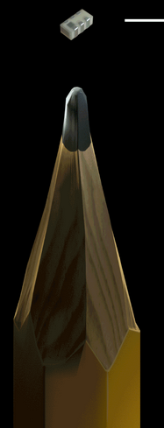

Slide 35


Slide 36


Slide 37
EXAMPLE

Slide 38
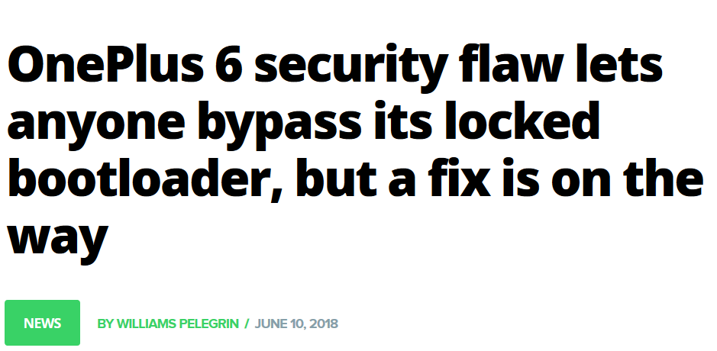
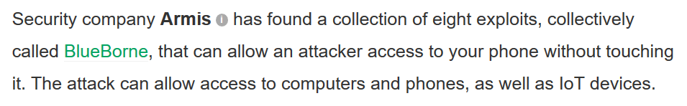

Slide 39
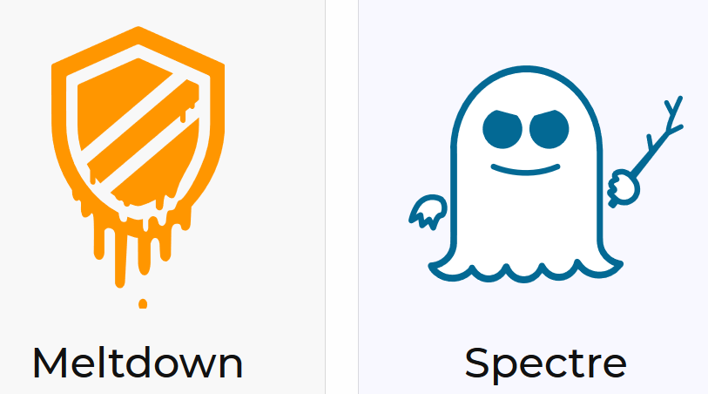
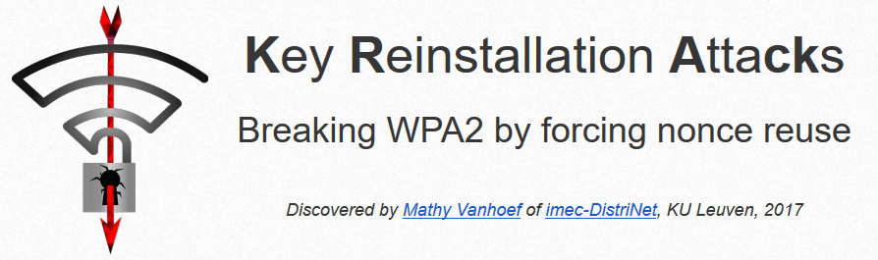

Slide 40
Survival tips
Always update your devices
Stay smart
Don’t click “Ignore” or “Continue anyway”
Don’t leave your devices unattended

Slide 41

Malware

Slide 42
Be smart yourself, computers can’t think
Trivial to compromise Windows and Android
Easy to compromise Mac OS
Anti-virus? Lol.
Spyware
Backdoor
Ransomware

Slide 43
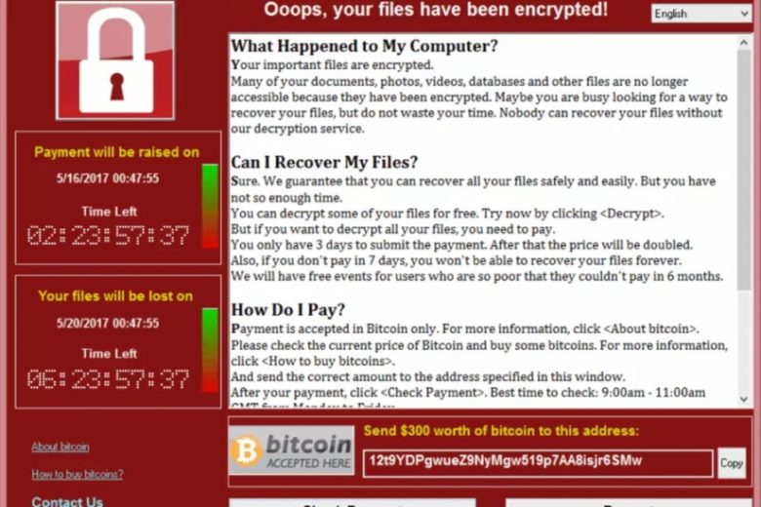

Slide 44
Survival tips
Be skeptical!
95% of casualties are due to social engineering
Installing suspicious apps, browsing suspicious websites
KEEP BACK UPS!
Also useful in case of hardware kaput

Slide 45
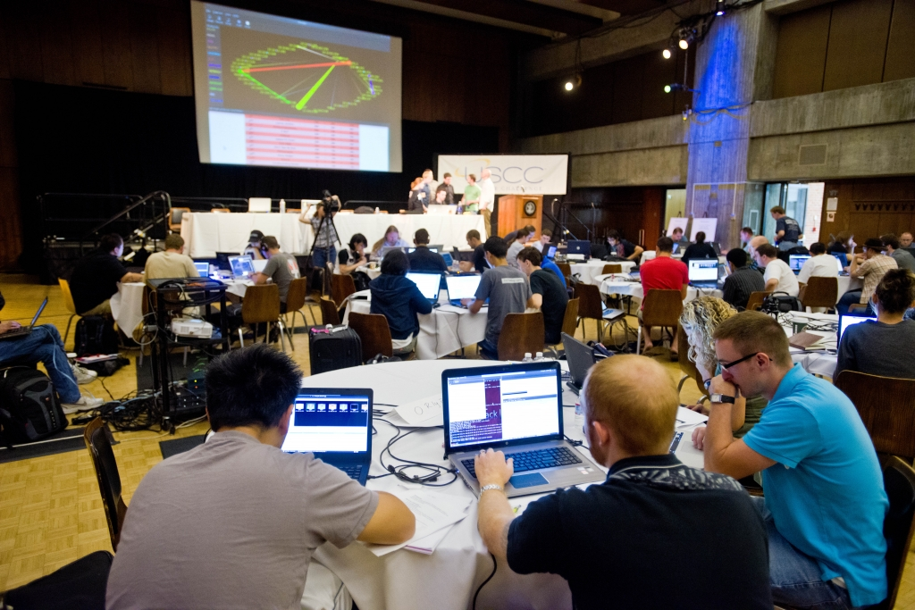
CTFs
Hacking for fun and profit

Slide 46
Capture the Flag (security edition)
Online
Physical
Jeopardy
Attack-defense

Slide 47
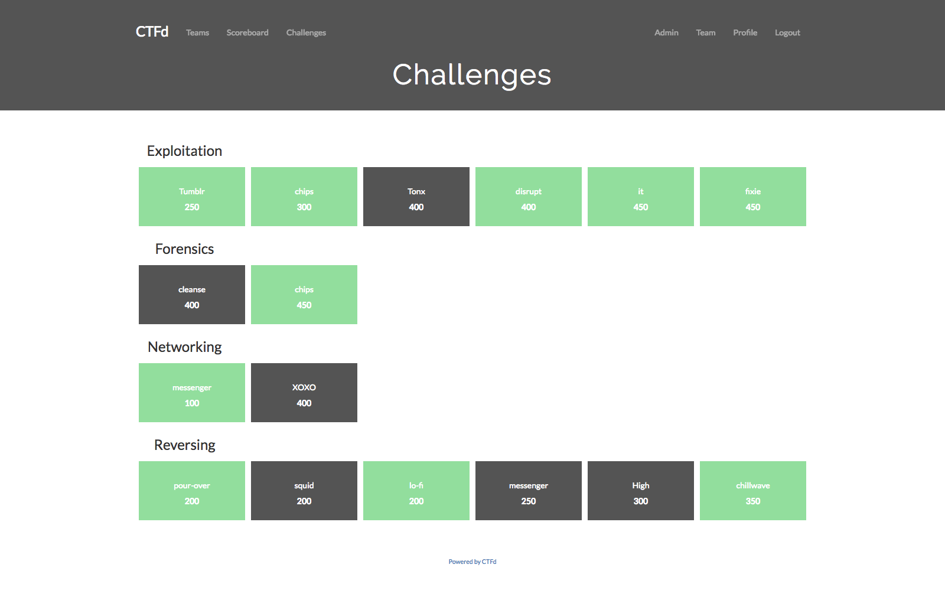

Slide 48
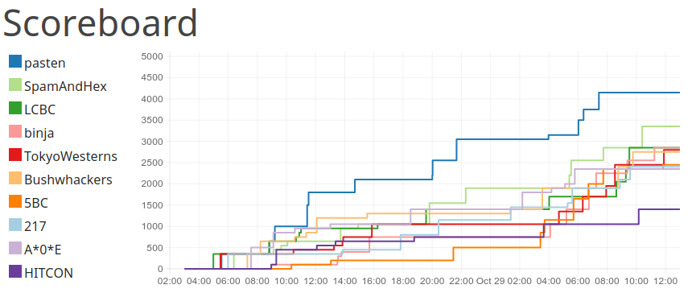

Slide 49
Get involved!

